Slide 1


Zomato–Restaurants Analysis

Slide 2

Group3:
Prashant Barde
Sahil Gupta
Rini Chhabra
Suraj Golesar
Sindhu Atmakuri
Adarsh kumar
Yash Gode
Micah George Salve
Rashika Shrirame
Agenda:
To Analyze the Zomato Restaurants data – for different countries and conclude what's steps needs to be taken to improve our application performance over different cities spared across globe – with help different KPI and dashboard that we have prepared on Excel, Tableau and Power BI – to analyze the data and study.

Slide 3
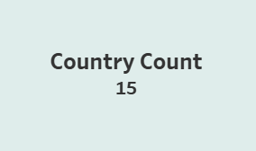
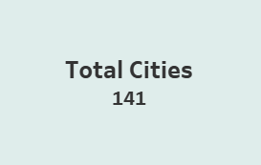
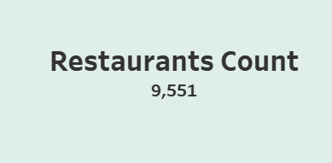
We have partners over 15 countries around the globe with 141 cities and total of 9551 restaurant's

Slide 4
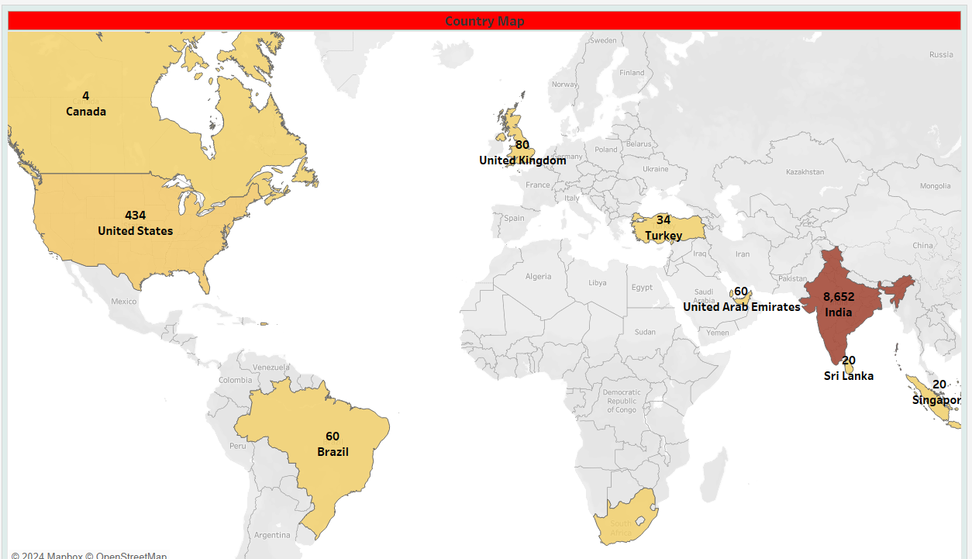
This particular visual shows reach of our application across the globe. In which we can see India is top country in the world which widely uses this application (over 8K restaurants) and then comes United states and United Kingdom (around 400+ and 80 odd restaurants)

Slide 5
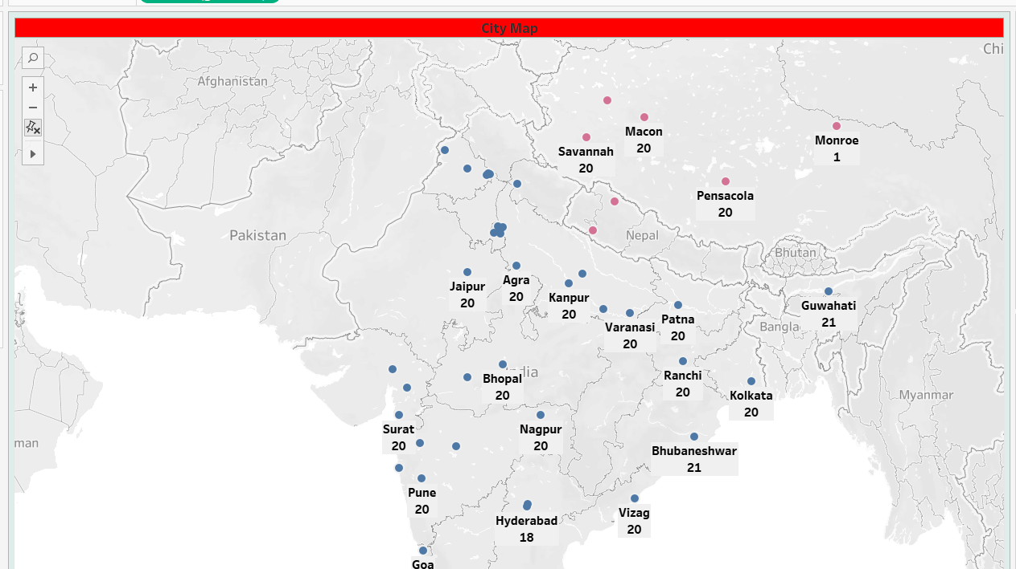
This visual shows the City wise Restaurants count – on focusing on INDIA – we can see Delhi has the highest number of restaurants which uses Zomato application as their Food delivering partner

Slide 6
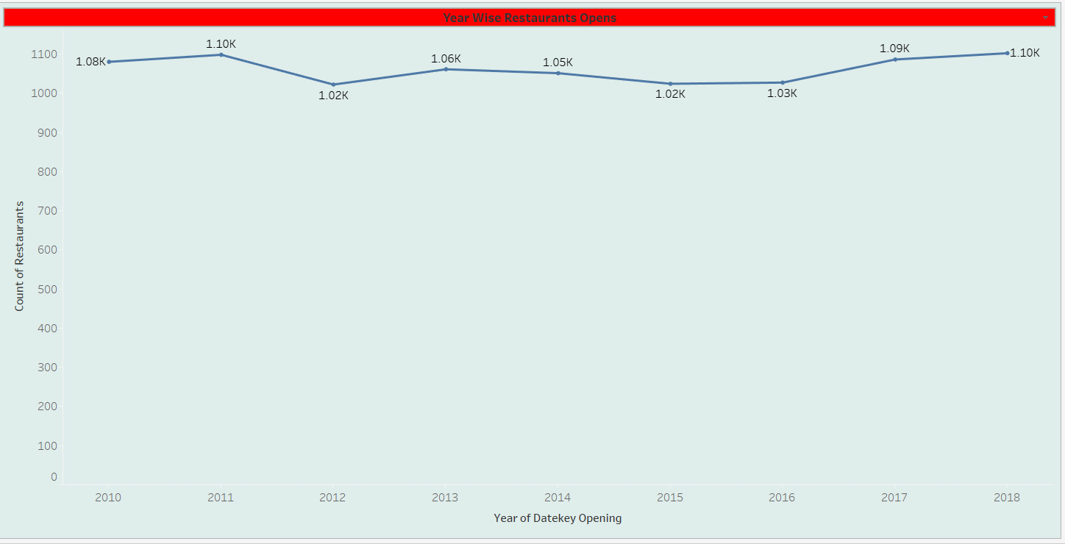
Restaurants Open Yearly: This shows the 8 years long Trend with Restaurants Opening every year having Zomato as their delivery partner

Slide 7
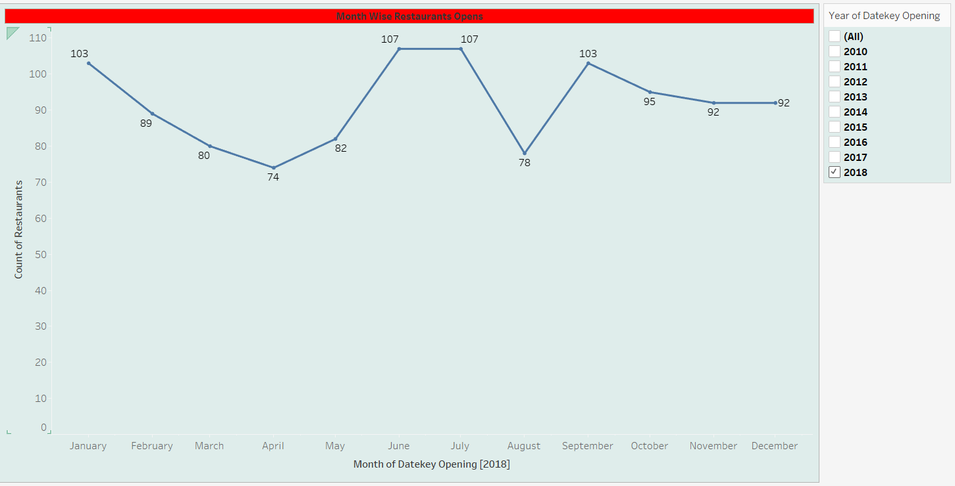
Restaurants Open monthly: This shows the 8 years long Trend with Restaurants Opening every Month having Zomato as their delivery partner

Slide 8
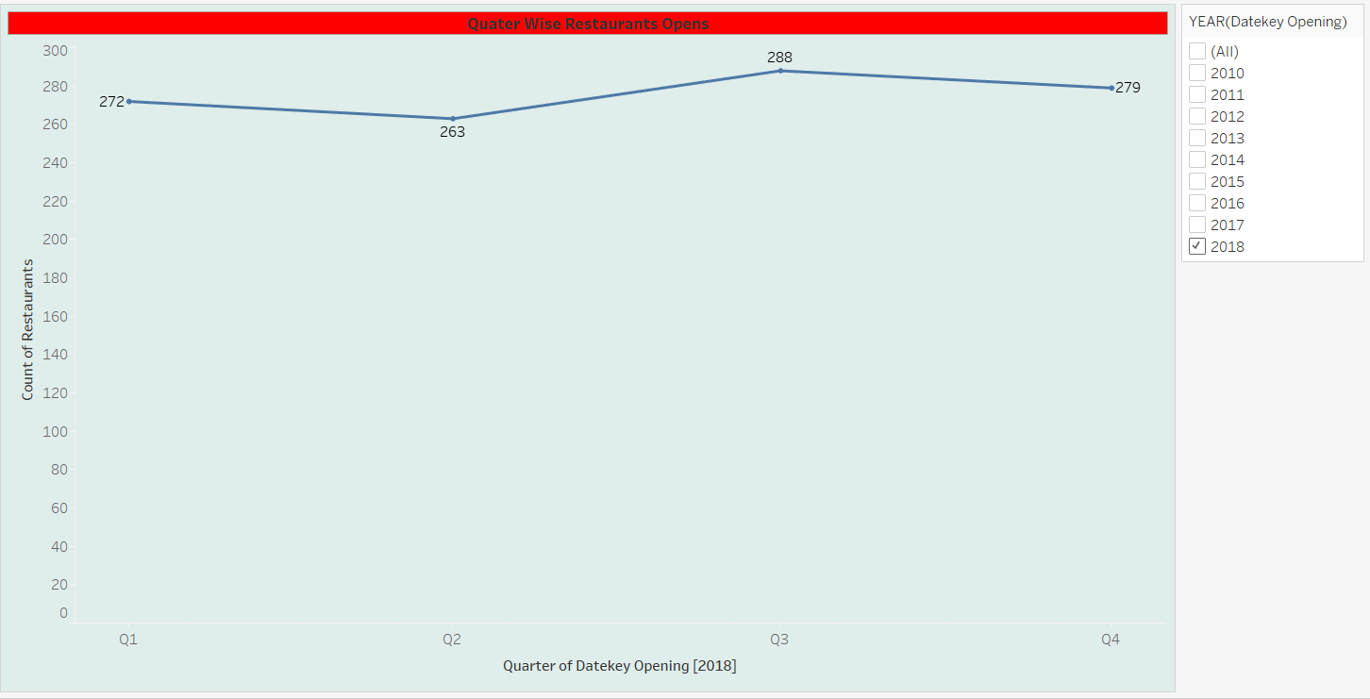
Restaurants Open Quarterly: This shows the 8 years long Trend with Restaurants Opening every quater having Zomato as their delivery partner

Slide 9
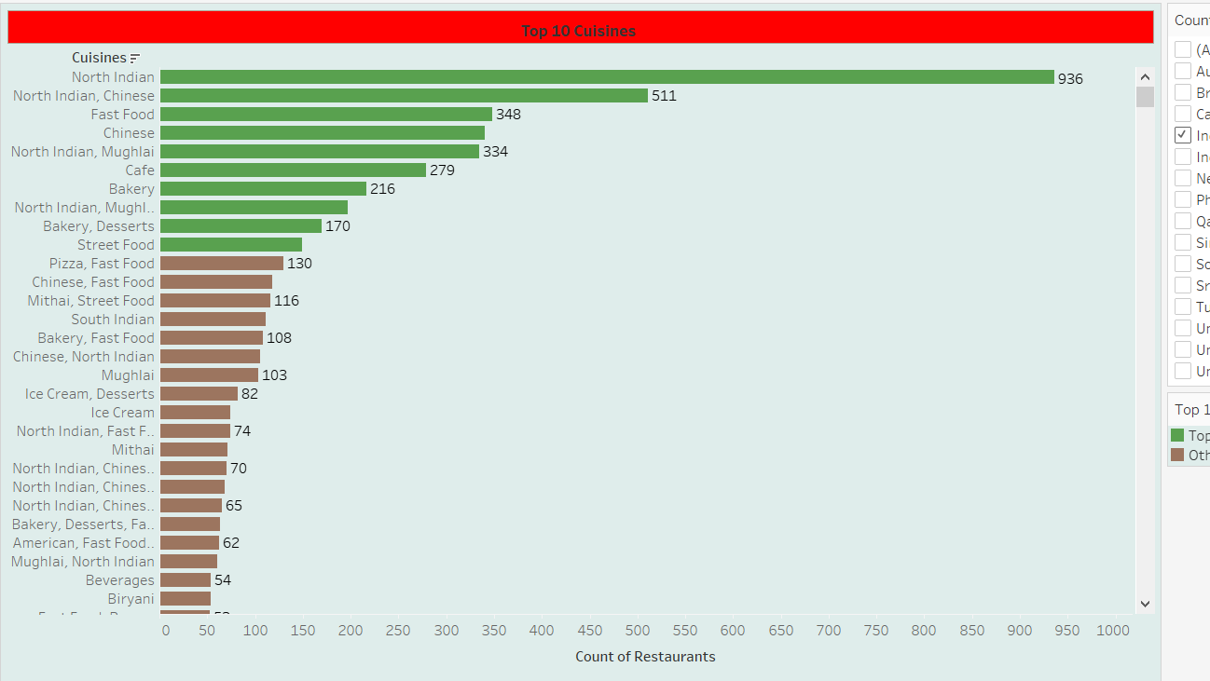
This visual shows – top cuisines from each country in Zomato being used as Food Delivery partner – as seen in India North Indian food in very much in demand by customers – we should make more restaurants tie-ups having - Good North Indian Food

Slide 10
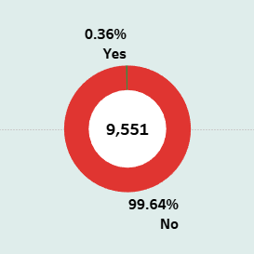
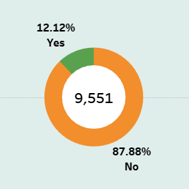
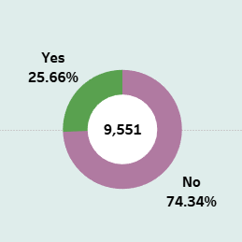
Restaurants – Delivering Food Online as of Today
Restaurants – Table booking
Restaurants – Delivering Food Online

Slide 11
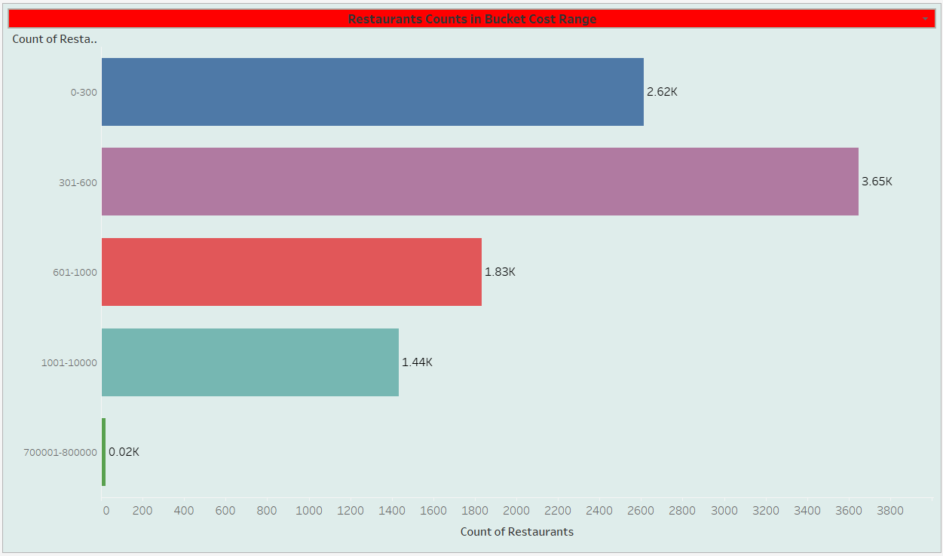

Slide 12
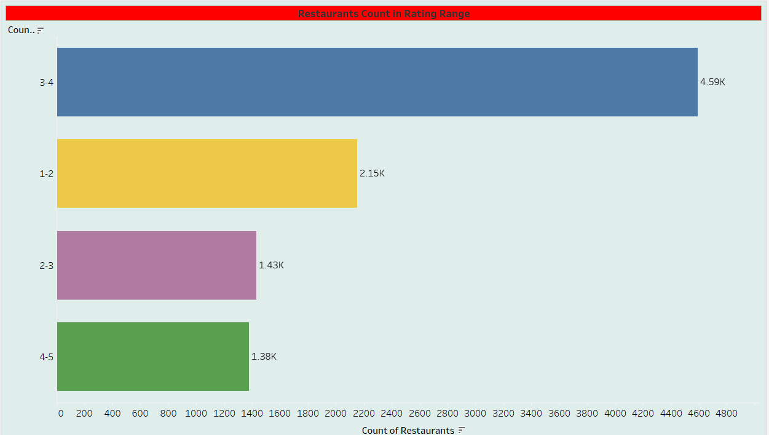

Slide 13
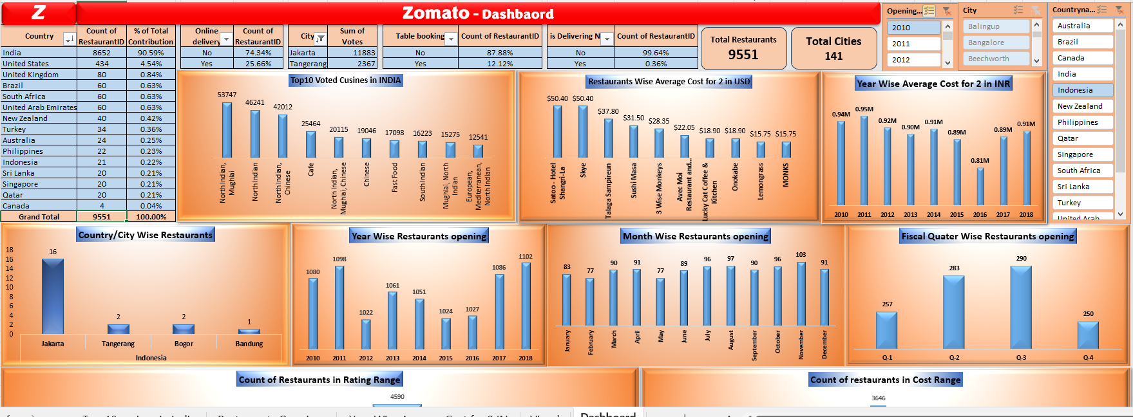
Excel - Dashboard

Slide 14
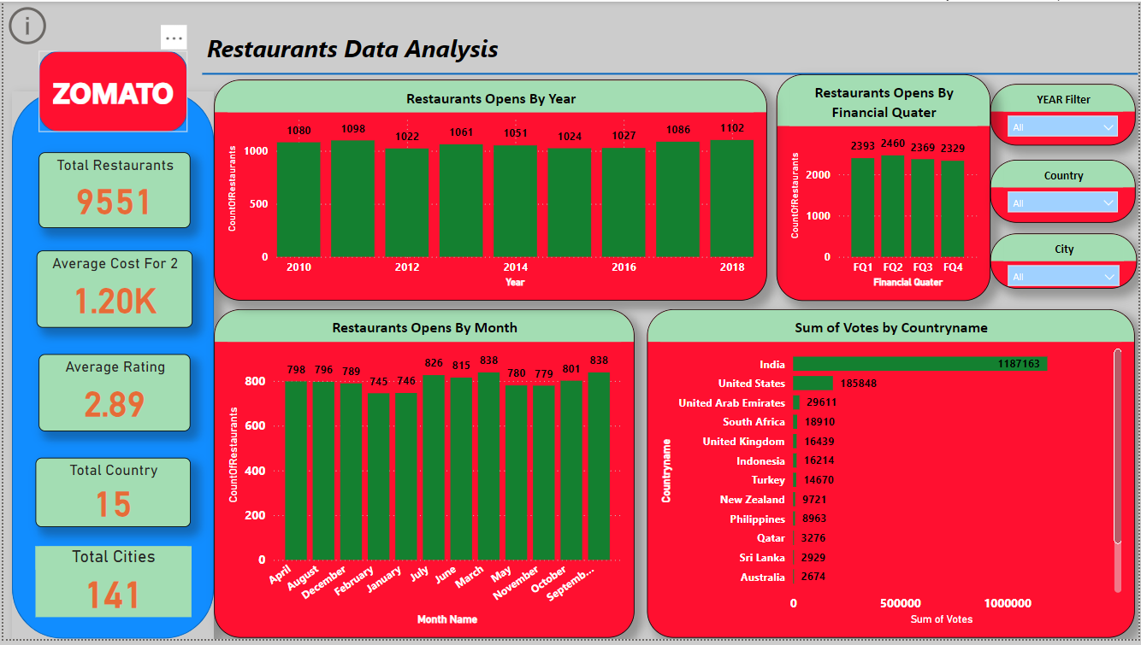
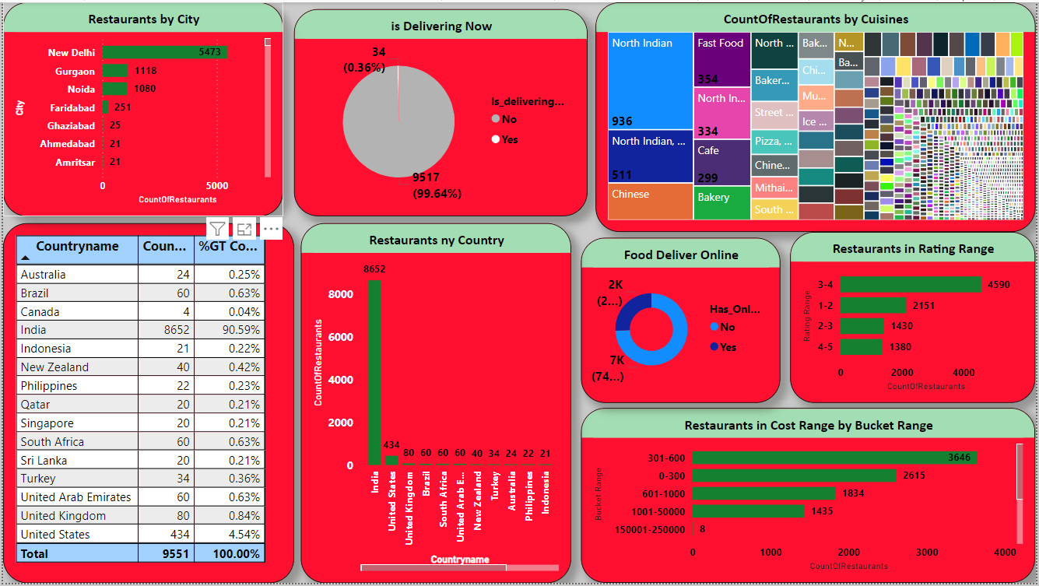
Power BI - Dashboard

Slide 15
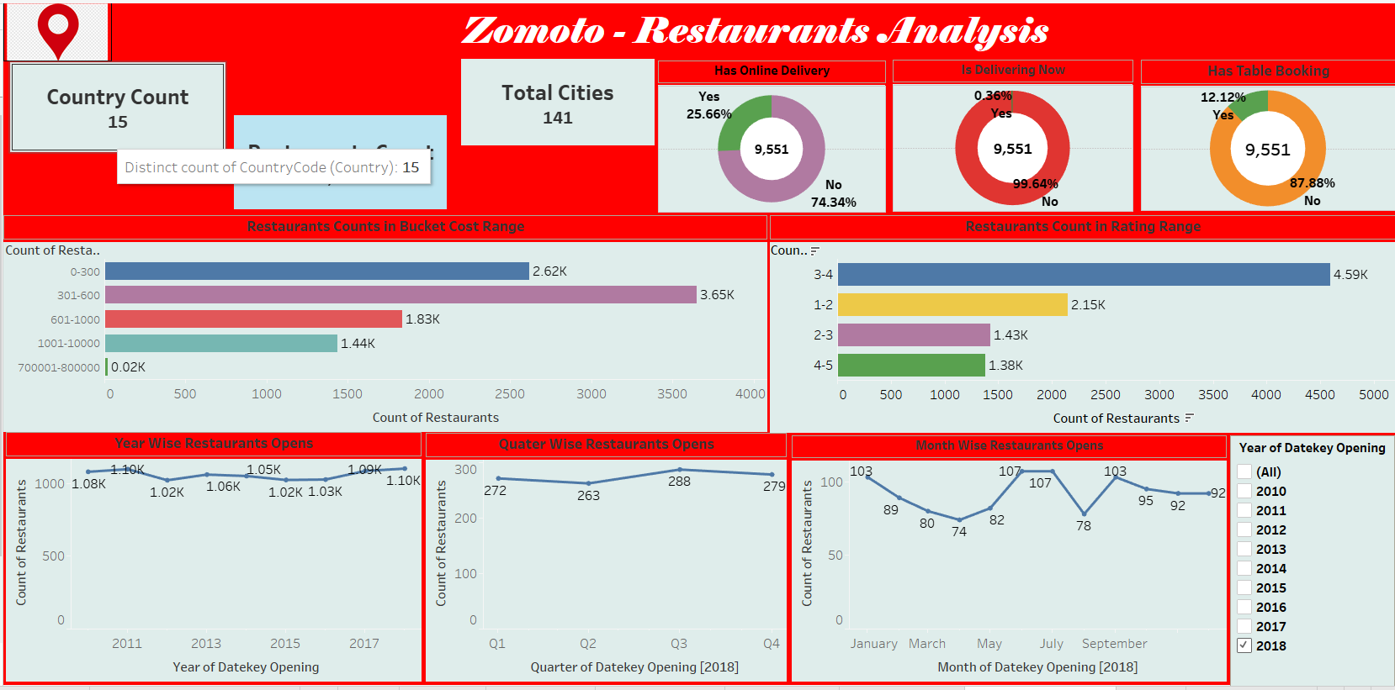
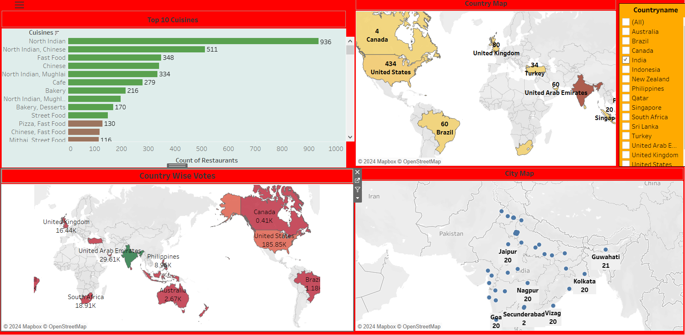
Tableau BI - Dashboard

Slide 16
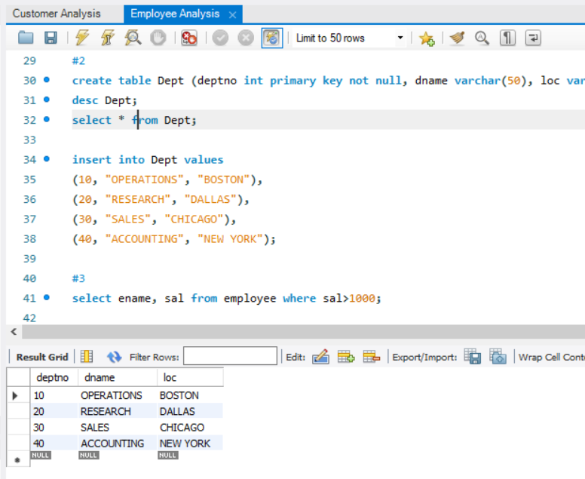
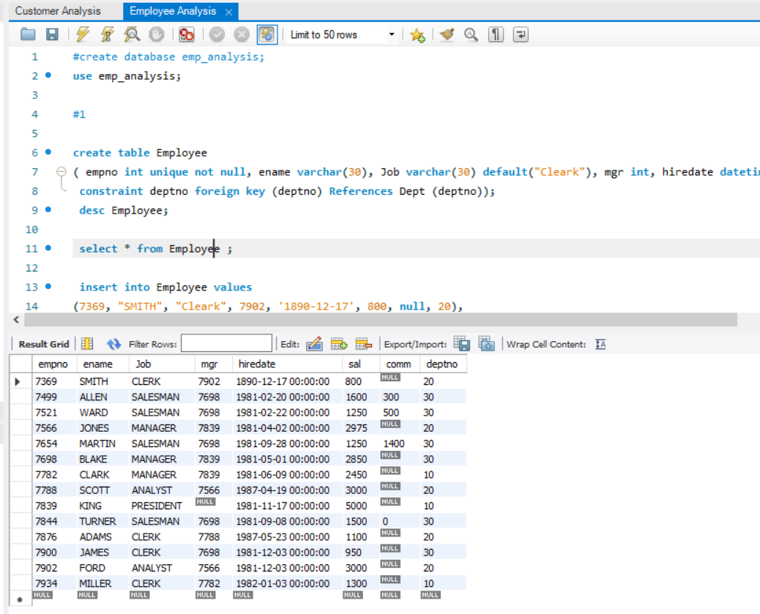
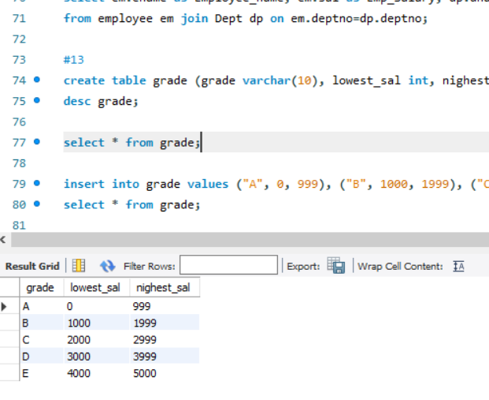
SQL- Assignment

Slide 17
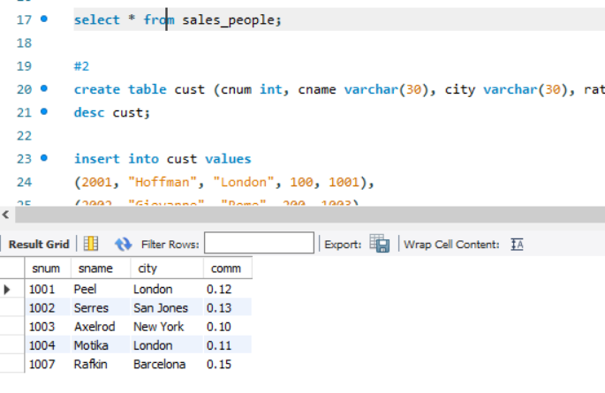
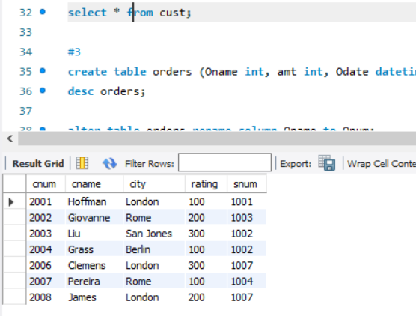
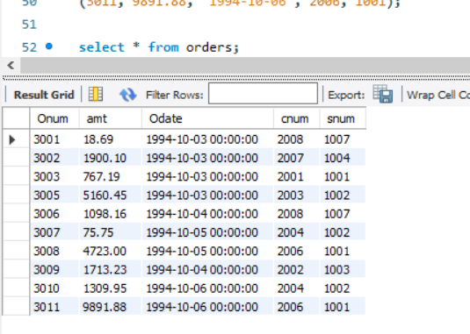
SQL- Assignment

Slide 18
THANK YOU ☺

